Slide 1
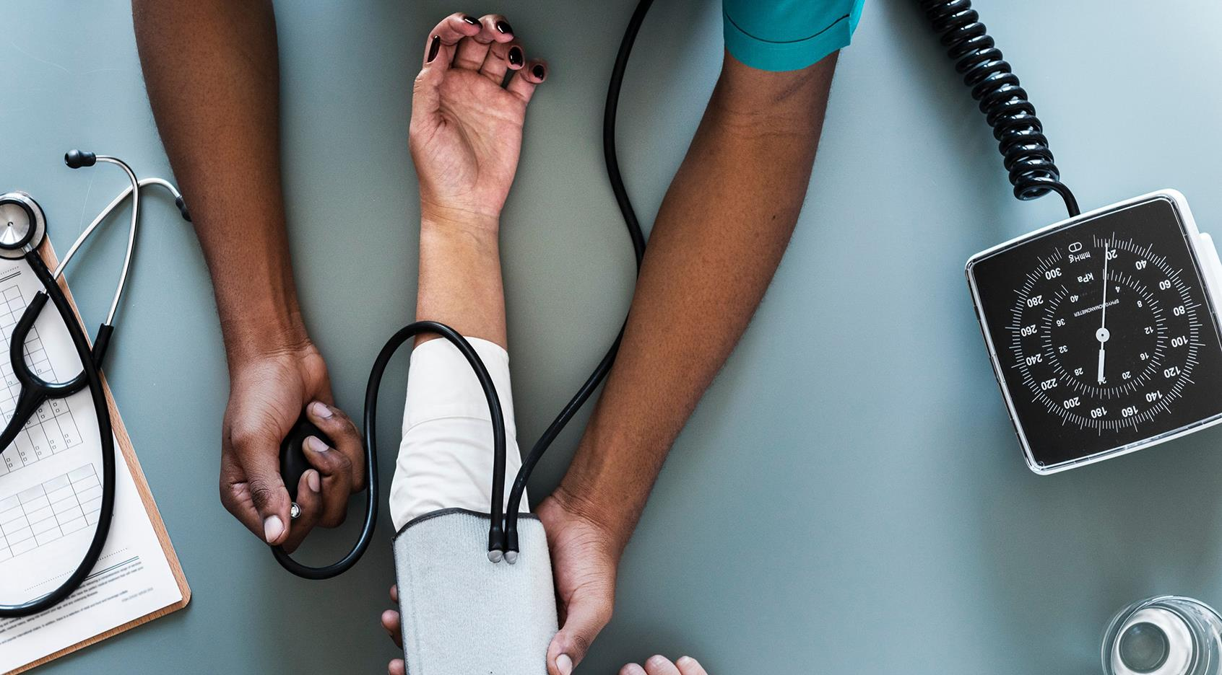
PHARMA
ESKİŞEHİR TECHNICAL UNIVERSITY
BİM437 SENIOR PROJECT

Slide 2
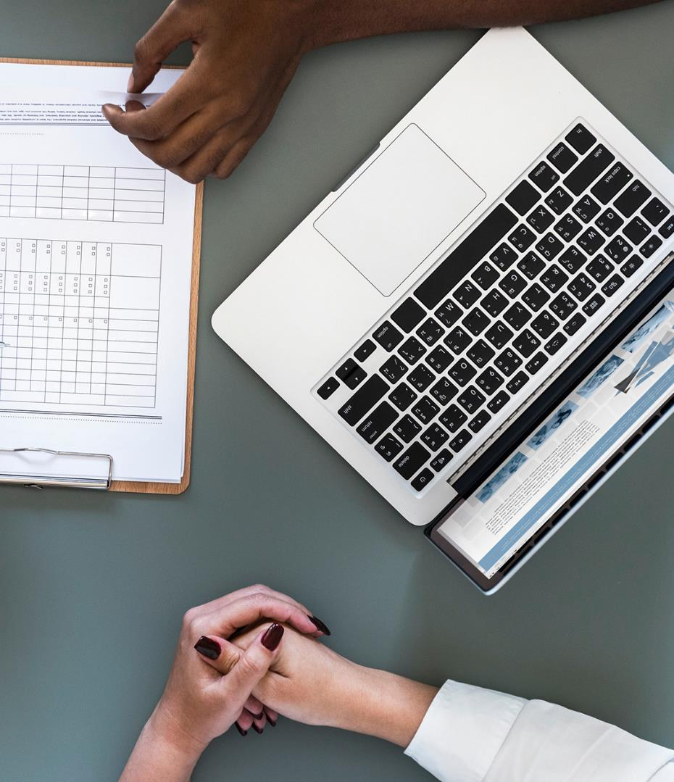
REVIEW OF PHARMA
The patients will be able to access to usage information of medicines.
Range
Usage Way
Dose
Max Usage Period
Our main aim is to inform the patients about the medicines they will use.

Slide 3
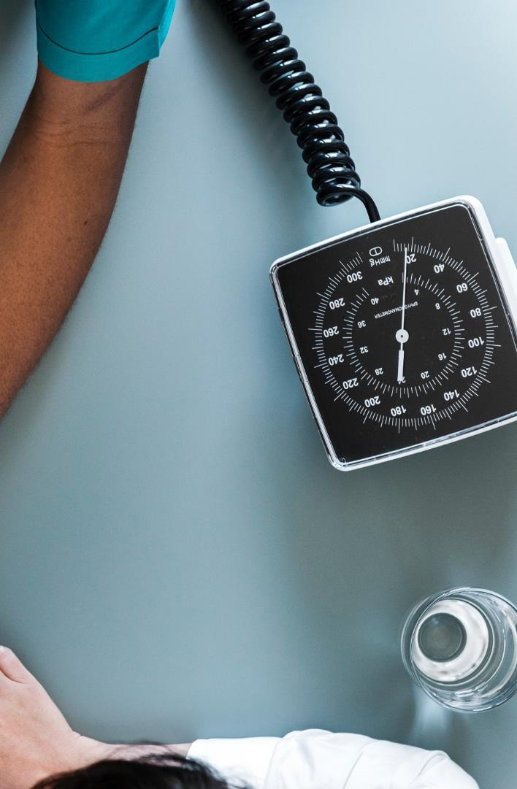



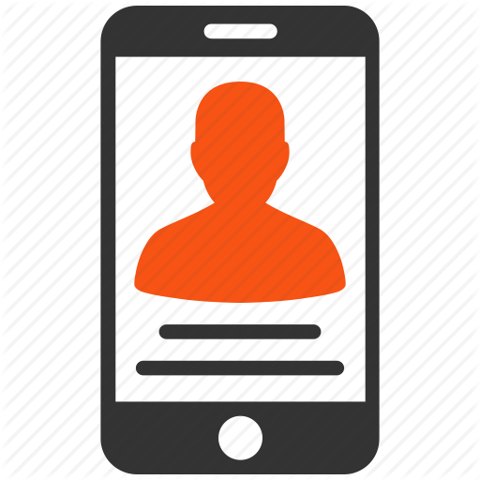
USERS
Admin Page
Doctor Page
Pharmacy Page
Patients Mobile App

Slide 4

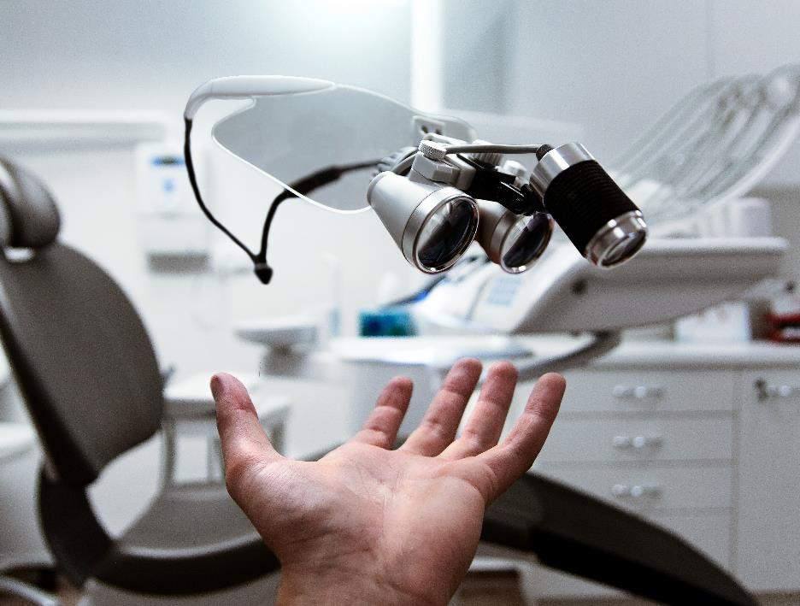
After doctors login, patients will scan own card then doctors will be able to see patients informations
And doctors will be able to prescribe to patients

Slide 5
TECHNOLOGIES
Arduino Uno
Microsoft Visual Studio
Microsoft SQL Server
Microsoft Azure
Android Studio

Slide 6
Project Schedule
Our one semester plan
Research
Test - Deploy
Feb, 2019
May, 2019
JAN
FEB
MAR
APR
MAY
2018
2019
Design
Programming
Feb, 2019
Mar,Apr, 2019

Slide 7

GOAL OF PROJECT
How to use the medicine of patients
When to use it
How often to use it with mobile application.

Slide 8

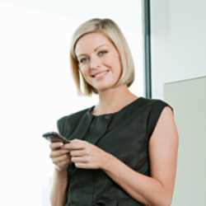
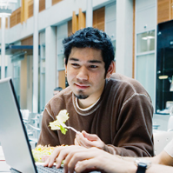

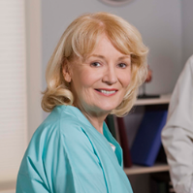
Team
Mirjam Nilsson
Victoria Lindqvist
Alexander Martensson
COO
COB
CFO
Angelica Astrom
Mira Karlsson
Flora Berggren
Head of Operations
Head of Technical
Creative Director

Slide 9


Thank You
Özgür Hasan Aytar
Gülşah Şahin
Tuğba Öztürk

